Slide 1
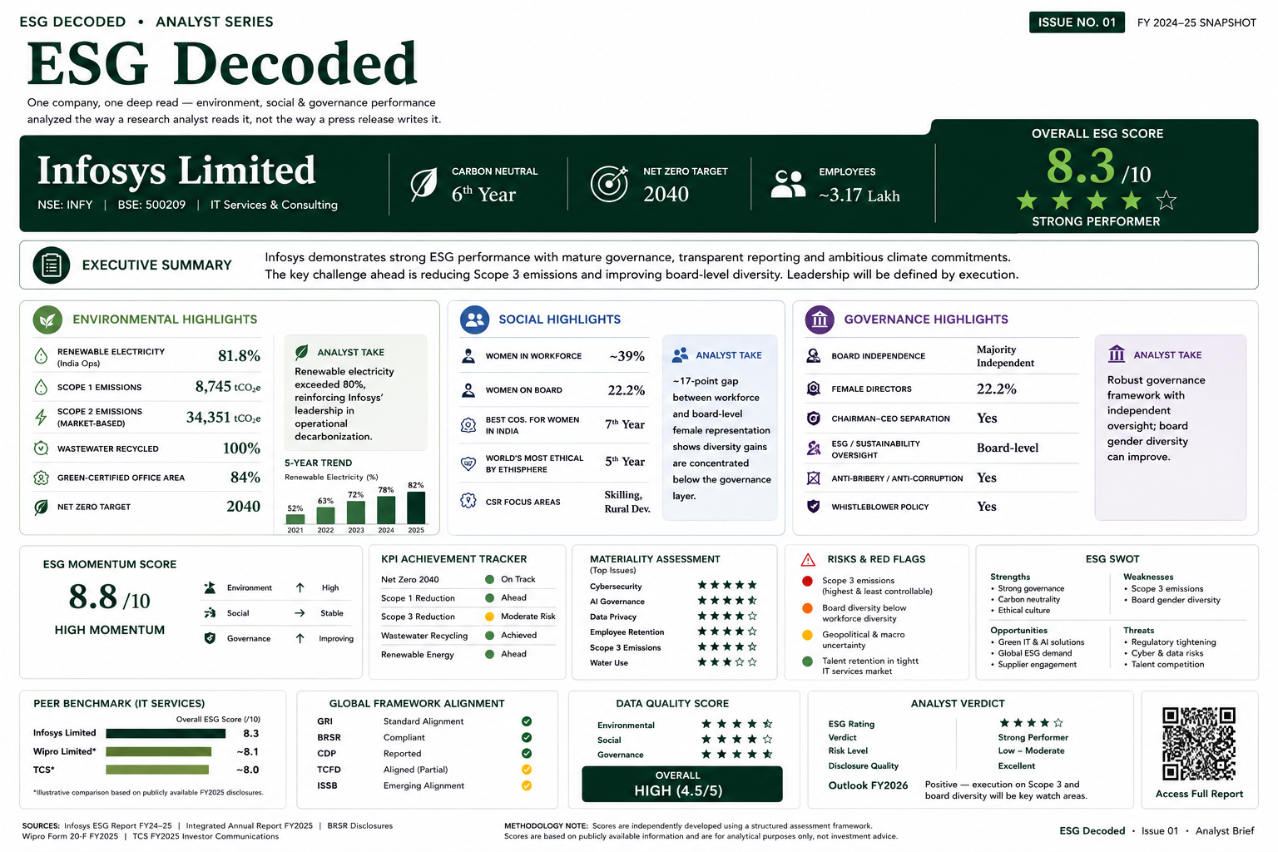

Slide 2
ESG DECODED
ESG Decoded
ISSUE NO. 01
Infosys Limited
FY2024–25 Analyst Brief
IT Services & Consulting
PREPARED BY
Prachi Singh
NSE: INFY · BSE: 500209

Slide 3
SECTION 01 · AT A GLANCE
Executive Summary
↑
ESG Maturity
Leading
OVERALL ESG SCORE
✓
Biggest Strength
Governance
8.3
out of 10
!
Biggest Risk
Strong Performer
Scope 3 Emissions
◎
FY2026 Watchlist
Board Diversity
ESG DECODED · ANALYST BRIEF · INFOSYS FY2024–25
02 / 10

Slide 4
SECTION 02 · COMPANY SNAPSHOT
Who Is Infosys, In Six Numbers
₹1.6 L Cr
~3,17,000
FY 2019–20
REVENUE (APPROX., FY25)
EMPLOYEES
CARBON NEUTRAL SINCE
81.8%
2040
Bengaluru, IN
RENEWABLE ELECTRICITY
NET ZERO TARGET
HEADQUARTERS
ESG DECODED · ANALYST BRIEF · INFOSYS FY2024–25
03 / 10

Slide 5
SECTION 03 · ENVIRONMENTAL
How Strong Is Infosys Environmentally?
81.8%
5-YEAR TREND
RENEWABLE ELECTRICITY : INDIA OPERATIONS
Carbon neutral for 6 consecutive years
Scope 2 emissions down ~18% year-on-year
Scope 3 remains the primary long-term challenge
ANALYST INSIGHT
Renewables passed 80% for the first time, the next test is Scope 3, not electricity sourcing.
ESG DECODED · ANALYST BRIEF · INFOSYS FY2024–25
04 / 10

Slide 6
SECTION 04 · SOCIAL
How Inclusive Is Infosys's Workforce?
39%
22.2%
7 Years
WOMEN WORKFORCE
WOMEN DIRECTORS
BEST COMPANIES FOR WOMEN (INDIA)
The ~17-point gap between workforce-level and board-level female representation shows diversity gains are concentrated below the governance layer, the next frontier for progress.
ESG DECODED · ANALYST BRIEF · INFOSYS FY2024–25
05 / 10

Slide 7
SECTION 05 · GOVERNANCE
Does the Board Structure Reduce Risk?
✓
✓
✓
✓
✓
BOARD
INDEPENDENT DIRECTORS
ESG COMMITTEE
CEO SEPARATION
WHISTLEBLOWER POLICY
Majority Independent
Chair Key Committees
Board-Level Oversight
Chairman ≠ CEO/MD
In Place
ANALYST VERDICT
A structurally independent board with clean chair/CEO separation, the single strongest pillar in this ESG profile.
ESG DECODED · ANALYST BRIEF · INFOSYS FY2024–25
06 / 10

Slide 8
SECTION 06 · TRENDS
Six Years of Compounding ESG Commitments
2019
2021
2023
2025
Carbon Neutral
Climate Positive Vision
80% Renewable
82% & Rising
Achieved across global operations
2030 ambition announced
Crossed for the first time
Vision 2030 targets tightened
Each milestone builds on the last, this is a company tightening its own targets, not resetting them.
ESG DECODED · ANALYST BRIEF · INFOSYS FY2024–25
07 / 10

Slide 9
SECTION 07 · ANALYSIS
Where Does Infosys Stand — And Where Is It Headed?
SWOT
MATERIALITY
STRENGTH
WEAKNESS
Cybersecurity
★★★★★
Independent governance
Scope 3 & board diversity
AI Governance
★★★★★
Data Privacy
★★★★★
OPPORTUNITY
THREAT
Scope 3 Emissions
★★★★☆
Green AI demand
AI/data regulation
Water Use
★★☆☆☆
ESG MOMENTUM SCORE
8.8 / 10
Environment ↑ High · Social → Stable · Governance ↑ Improving
ESG DECODED · ANALYST BRIEF · INFOSYS FY2024–25
08 / 10

Slide 10
SECTION 08 · BENCHMARK
How Does Infosys Compare to IT Services Peers?
FRAMEWORK ALIGNMENT
GRI
✓ Aligned
BRSR
✓ Aligned
CDP
✓ Reported
TCFD
◐ Partial
ISSB
◐ Emerging
Illustrative comparison based on publicly disclosed FY2025 information; peer figures are directional estimates.
ESG DECODED · ANALYST BRIEF · INFOSYS FY2024–25
09 / 10

Slide 11
SECTION 09 · CONCLUSION
Final Verdict
OVERALL ESG SCORE
KEY STRENGTHS
KEY RISKS
NEXT WATCHLIST
8.3
Mature, independent governance
Scope 3 emissions trajectory
Scope 3 disclosure cadence
/ 10
Tightening climate targets
Board-level gender diversity
Board diversity progression
★★★★☆
Assured disclosure quality
Supplier sustainability gaps
AI governance maturity
Strong Performer
SOURCES
Infosys ESG Report FY24–25 · Integrated Annual Report FY2025 · BRSR disclosures · Wipro Form 20-F FY2025 · TCS FY2025 investor communications.
This report is analyst-style commentary compiled from public disclosures, not investment advice. Figures marked "~" are best-available public estimates.
ESG Decoded · Issue 01 · Analyst Brief
End of Brief

